Slide 1
VASCULITIS ( Part 2)
Mustafa E. Al-Badran
CABM FIBMS
Internist & Rheumatologist

Slide 2
Notes:
Chapel Hill classification 2012

Slide 3
Large Vessel Vasculitis
Takayasu Arteritis
Giant Cell Arteritis & Polymyalgia Rheumatica

Slide 4
Takayasu arteritis
Large vessels arteritis affects the aorta, its major branches and occasionally the pulmonary arteries
The typical age at onset is 25–30 years, with an 8 : 1 female-to-male ratio, most common in Asia
It is characterised by granulomatous inflammation of the vessel wall, leading to occlusion or weakening

Slide 5
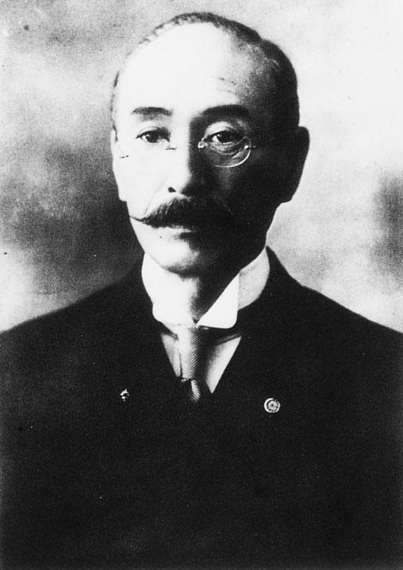
Mikito Takayasu (1860 - 1938) Japanese ophthalmologist

Slide 6
CLINICAL FEATURES
Symptoms
Claudication
Fever
Arthralgia
Weight loss
Signs
Loss of pulses
Bruits
Hypertension
Aortic incompetence

Slide 7
Diagnosis
By angiography, which reveals Coarctation, occlusion &aneurysmal dilatation
Treatment
High-dose glucocorticoids and immunosuppressants, as described for ANCA-associated vasculitis

Slide 8
An MRA showing occlusion of the left subclavian artery and significant narrowing of the left common carotid artery

Slide 9
Giant Cell Arteritis (Cranial arteritis, Temporal arteritis) and Polymyalgia Rheumatica
Giant Cell Arteritis :Granulomatous arteritis that affects large and medium-sized arteries
It is commonly associated with polymyalgia rheumatica (Polymyalgia rheumatica may occur concurrently with (40%-60%), or precede (20%), a diagnosis of GCA
The average age at onset is 70, with a female-to-male ratio of about 3 : 1

Slide 10
Clinical features (PMR)
Symmetrical, Neck, shoulder and pelvic girdle pain
Stiffness and painful restriction of active shoulder movements on waking
Muscles are not tender, and weakness and muscle-wasting are absent

Slide 11
Clinical features (GCA)
Localized headache(temporal or occipital) may accompanied by scalp tenderness (cardinal symptom (
Jaw pain brought on by chewing or talking (Jaw Claudication)
Catastrophic presentation with unilateral blindness (occlusion of the posterior ciliary artery) 10%
Transient ischaemic attacks or Hemiparesis
Brainstem infarcts
Neurological involvement (Rare)
Notes:
Anterior Ischemic optic neuritis results from arteritis involving the posterior ciliary branches of the ophthalmic arteries

Slide 12
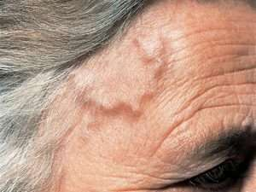
Temporal artery abnormality

Slide 13
Investigations
Elevated ESR, CRP
Normochromic, Normocytic anaemia
Temporal artery biopsy (skip’ lesions)
Fragmentation of the internal elastic lamina
Necrosis of the media
Mixed inflammatory cell infiltrate
Ultrasound of the temporal artery
FDG PET scan (Highly specific but insensitive)
Rarely, PMR and GCA can present with a normal ESR
Halo Sign
Notes:
Florodeoxyglucose positron emission tomography (19FDG PET scan).

Slide 14
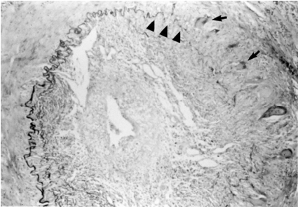
Temporal artery biopsy in a patient with giant cell arteritis showing the disrupted internal elastic lamina (arrowheads) and giant cells (arrows)

Slide 15
‘Halo sign’ of GCA: hypoechoic area (asterisk) around the temporal artery in longitudinal view (A) and transverse view (B)

Slide 16
Treatment
In suspected GCA
In PMR
Prednisolone (60-80 mg) should be began urgently because of the risk of blindness
Prednisolone (15–20 mg)
The response to steroid is dramatic and symptoms will completely resolve within 48–72 hours

Slide 17
In both conditions, the glucocorticoid dose should be progressively reduced, guided by symptoms and ESR, with the aim of reaching a dose of 10–15 mg by about 8 weeks , Then the rate of reduction should be slowed by 1 mg per month
If symptoms recur, the dose should be increased to that which previously controlled the symptoms, and reduction attempted again in another few weeks
Most patients need glucocorticoids for an average of 12–24 months and all patients needs prophylaxis against giant cell induced osteoporosis

Slide 18
